Slide 1


Introduction to Traveling and Tourism
Traveling and tourism open doors to new experiences and cultures.

Slide 2
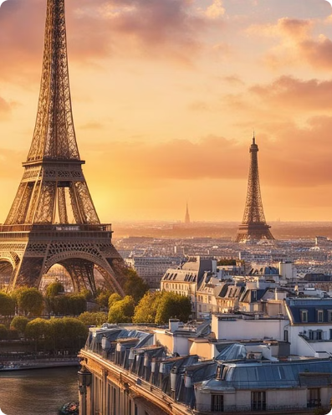
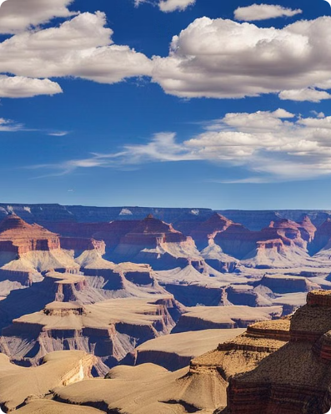
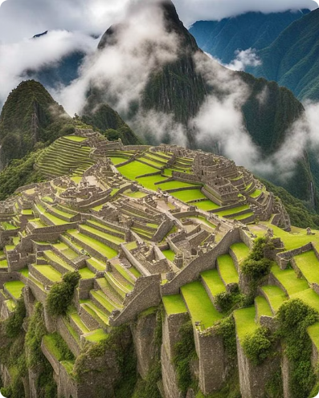
Popular Tourist Destinations
Paris, France
Grand Canyon, USA
Machu Picchu, Peru
Experience the charm of the City of Love, known for its iconic landmarks, art, and delectable cuisine.
Marvel at the natural wonder of the world and explore the unique geological formations of this ancient canyon.
Embark on a journey to the mystical Incan citadel, nestled amidst breathtaking Andean landscapes.

Slide 3
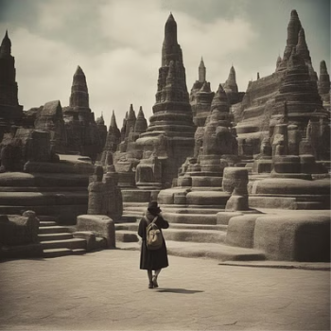
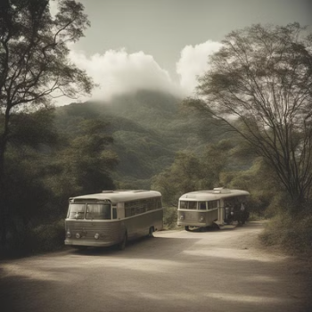
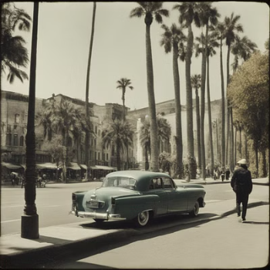
Types of Tourism
Adventure Tourism Eco-Tourism Cultural Tourism

Slide 4

Planning a Trip
1
Destination Selection
Research and choose the ideal location based on interests and preferences.
2
Itinerary Planning
Create a detailed itinerary including activities, attractions, and approximate schedules.
3
Accommodation Booking
Secure suitable accommodation based on budget, location, and amenities.

Slide 5

Transportation options
When it comes to traveling, there are various transportation options available, from modern high-speed trains with spacious, comfortable seating to convenient public buses and trams that offer affordable city travel.

Slide 6

Accommodation choices
When it comes to accommodations, travelers have a plethora of options ranging from luxurious hotels to cozy bed and breakfasts. Each type of lodging offers a unique experience, whether it's the pampering of a resort or the charm of a boutique hotel.
]

Slide 7

Travel Tips and Safety Precautions
Pack Light: Consider the weight restrictions for flights and the amount of walking you may have to do.
Stay Informed: Research your destination's safety guidelines and any travel advisories.
Emergency Contacts: Keep a list of emergency numbers for the country you are visiting on hand.

Slide 8
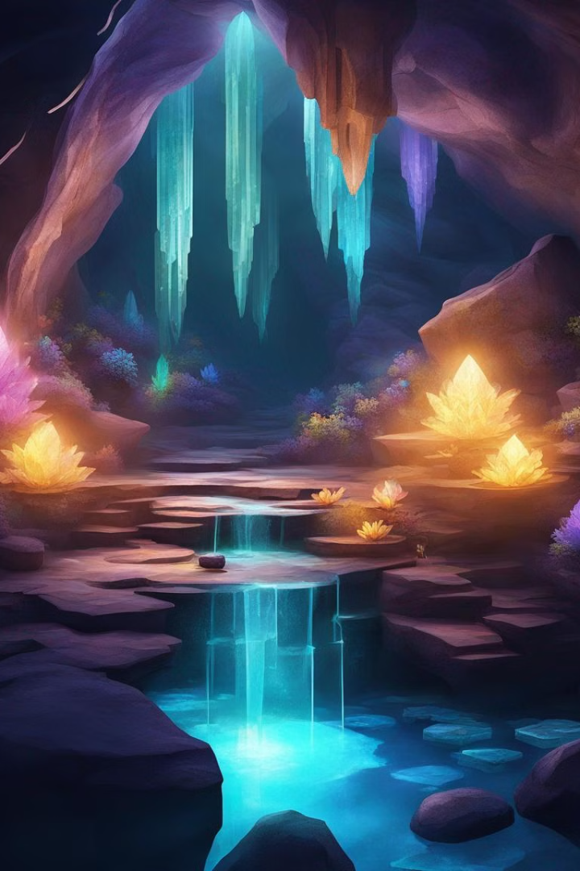
Journey to the Center of Earth
Embark on a mystical journey to the earth's core, where ancient secrets and untold wonders await beneath the surface. Explore the mysterious depths of the planet, filled with glowing crystals, underground rivers, and otherworldly landscapes.

Slide 9
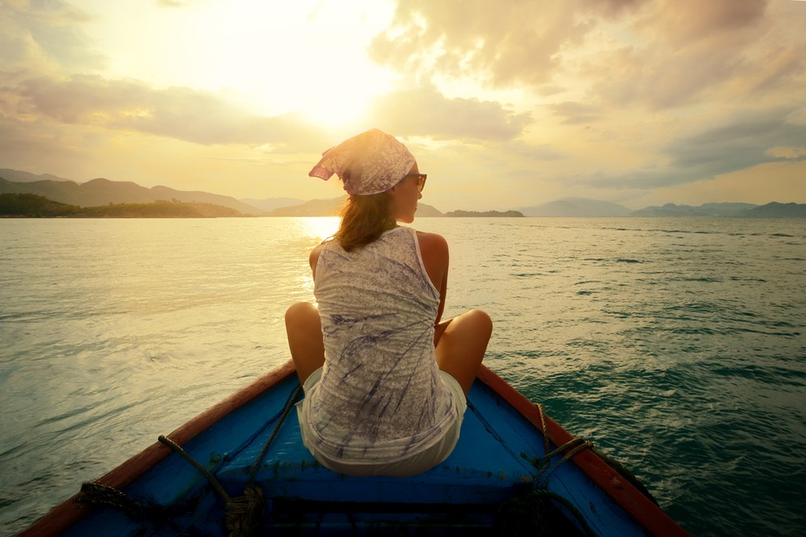
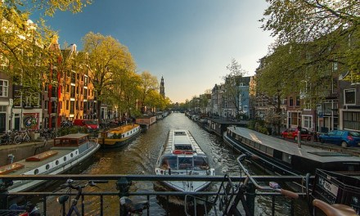

Road Trip Adventures
"Embarking on Epic Journeys by Land“
Personal Growth Cultural Environment Stress Relief

Slide 10
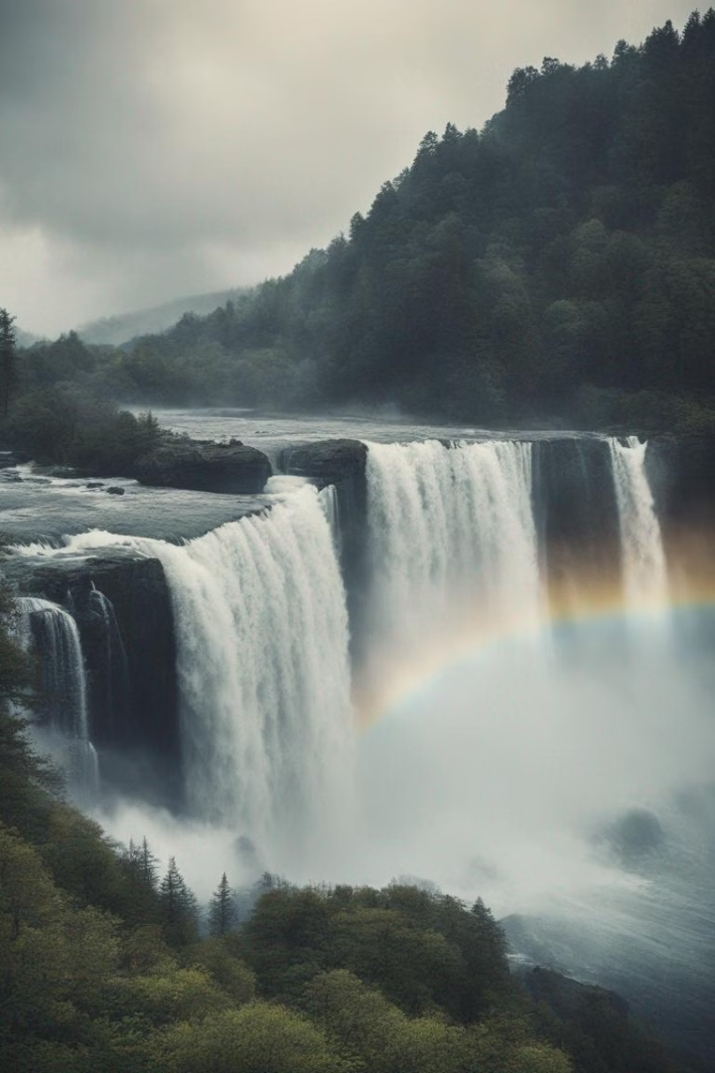
The Roar of the Falls
Standing in awe as the thunderous roar of the majestic waterfall creates a sense of wonder and excitement. The streaming water crashes against the rocks, creating a mesmerizing spray and a captivating rainbow in the mist.

Slide 11
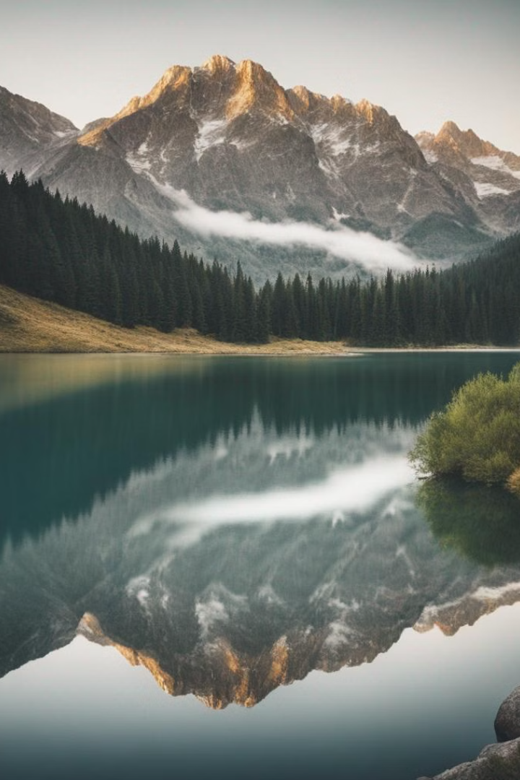
Mountain Majesty
Explore the breathtaking beauty of the snow-capped peaks adorned with a golden glow from the sunlight. The serene alpine landscape offers an escape into the heart of nature's grandeur.Traverse through winding trails, witness panoramic vistas, and bask in the tranquil aura of majestic mountains.

Slide 12
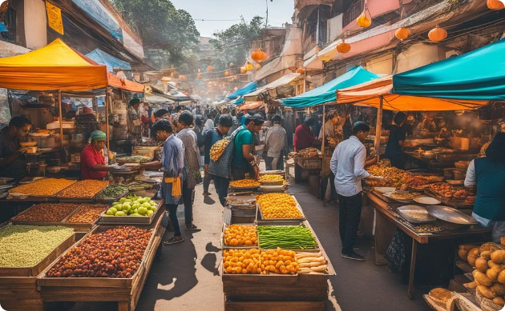

Foodie Adventures
Local Street Food
Fine Dining Delights
Explore the vibrant street food markets with a wide variety of cuisines on display amidst a bustling atmosphere.
Indulge in elegant fine dining experiences with beautifully presented gourmet dishes in stylish and sophisticated settings.

Slide 13
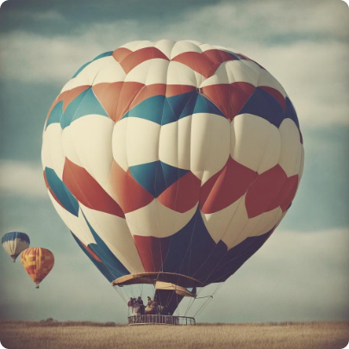
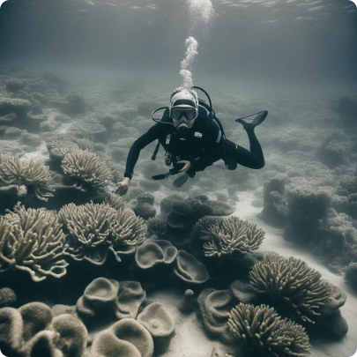

Bucket List Experiences
Hot Air Balloon Ride
Scuba Diving Adventure
Skydiving Thrill
Experience the tranquility of soaring above picturesque landscapes at sunrise or sunset.
Explore vibrant coral reefs and encounter remarkable marine life in crystal-clear waters.
Feel an adrenaline rush as you freefall from an airplane and revel in breathtaking aerial views.

Slide 14

Conclusion and Final Thoughts
Thank you for joining us on this journey through theworld of traveling and tourism. We hope these insights have inspired you to plan your next adventure, whether it's exploring new destinations or revisiting old favorites.

Slide 15
THANK YOU!!!

